Slide 1
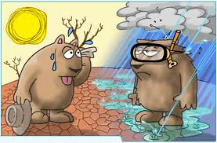
Climate Change

Slide 2
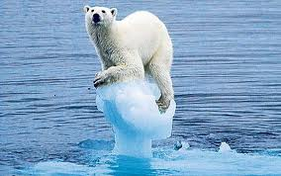
Global Warming
= is the observed rise in the earth’s temperatures.
Thought to be caused by an increase greenhouse gases
Human activities (anything that burns fossil fuels) adds greenhouse gases.

Slide 3
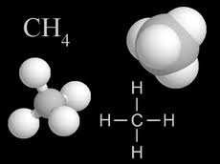
Greenhouse Gases
Water vapour (H₂O)
Carbon dioxide (CO₂ )
Methane (CH₄),
Nitrous oxide (NO₂)
Greenhouse gases absorb and re-emit heat back to earth.

Slide 4
Greenhouse Effect
= trapping of heat energy near Earth’s surface.
Without greenhouse effect, our earth would be VERY cold!! We do need it.
Human activities have increased this effect
“enhanced greenhouse effect”

Slide 5
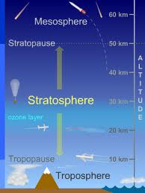
Ozone Layer
There is a layer of O₃ in the stratosphere (15 – 50 km above earth) that shields us from ultraviolet radiation (UV).
Sunblock has UV block in it. UV burns skin.
CFC’s (chemical) have depleted some ozone therefore more UV gets through.

Slide 6
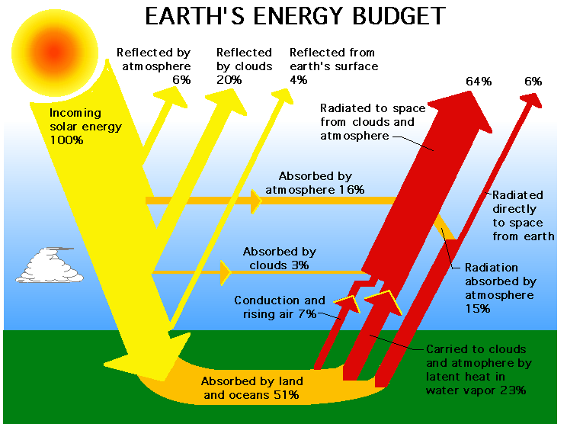
Earth’s Energy Budget

Slide 7
Homework
Read p. 331 – 332 Do #3 on page 335
Read p. 338 – 342 Do #1, 3-7 on page 342

