Slide 1
Impacts of Climate change

Slide 2
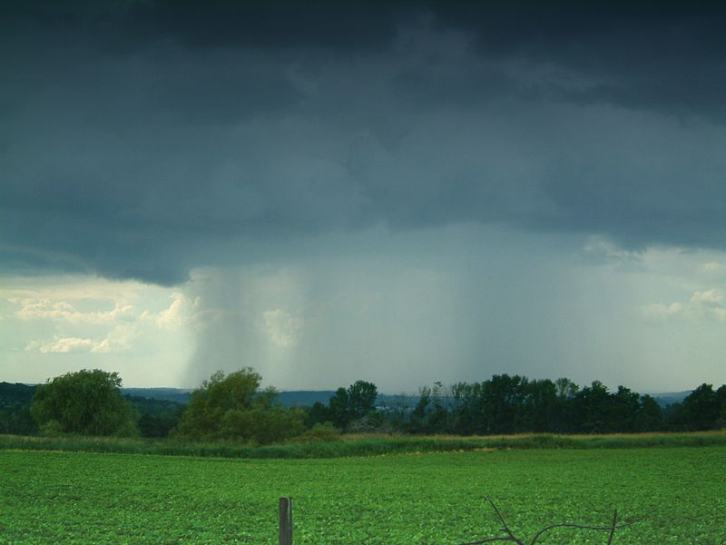
Warmer, wetter weather

Slide 3
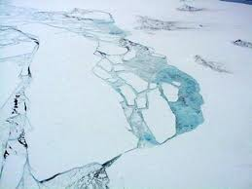
Melting glaciers, ice sheets and sea ice

Slide 4
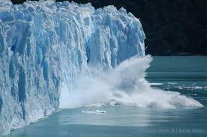
Rising water levels due to melting ground ice & thermal expansion
Thermal expansion = water expands slightly when it warms up.

Slide 5
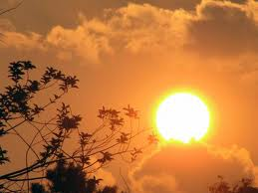
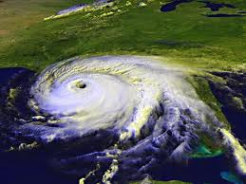
Increase in severe weather such as heat waves & hurricanes

Slide 6
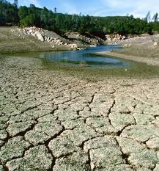
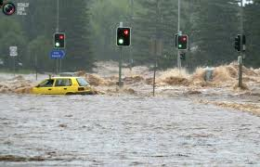
Changes in precipitation: some areas will experience more & some areas will experience droughts.

Slide 7
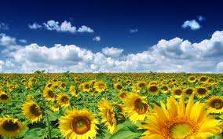
Changing seasons – lengths change – ie: longer summers.

Slide 8
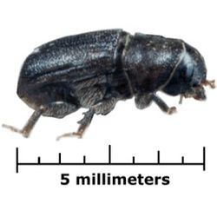
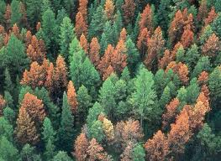
Changes in geographic patterns & disruption of ecosystems
So...as planet warms up, some animals will migrate to poles where it is cooler

Slide 9
Homework
Read p. 373 – 378
Answer # 1-7 p. 378

