Slide 1
Patterns in the Periodic Table
All elements in the same column have similar chemical and physical properties
This is how it is possible to predict the properties of any element, simply by its location in the periodic table
CHEMICAL FAMILY – elements in the same column belong to the same group or chemical family

Slide 2
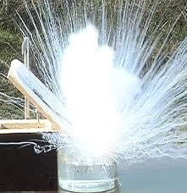
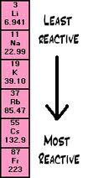
Group 1 – ALKALI METALS
First column on the left
They are shiny, silvery, and soft
HIGHLY REACTIVE METALS
These elements are rarely seen on their own, they combine readily with other elements

