Slide 1
SNC 2D Chemistry Unit PROPERTIES OF MATTER

Slide 2
Physical Properties
A characteristic of a substance.
Describe what a substance looks like.
Example: colour
texture
state
hardness
solubility

Slide 3
Types of Physical Properties
Mass size
Density volume
Area viscosity
Boiling point
melting point
solubility
Colour
Shape
Taste
Clarity
odour
Quantitative
Can be measured
Qualitative
Can not be measured

Slide 4
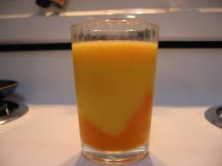
Characteristic Physical Properties
A physical property that is unique to a substance and that can be used to identify the substance
Examples: density
melting point
boiling point

Slide 5
Chemical Properties
A characteristic behaviour that occurs when a substance changes to a new substance.
Example: reaction with acid
combustibility

Slide 6
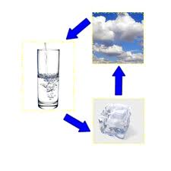
Physical Change
A change in the size or form of a substance, which does not change the chemical properties of a substance.
NO NEW SUBSTANCE IS FORMED!!

Slide 7
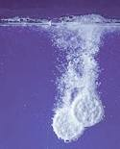
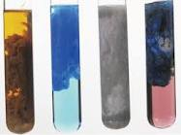
Chemical Change A new substance is formed (Usually irreversible)
Indicators of a chemical change:
Bubbles formed
Precipitate formed
Heat produced
Colour change

Slide 8
Practice: Chemical or Physical change?
Cutting bread _____________
A nail rusting _____________
Wood burning in a fire _____________
A mirror shattering _____________
A paper clip bending _____________
Baking a cake _____________

