Slide 1
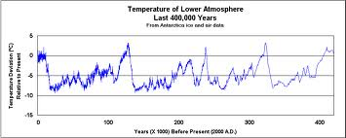
Studying Past Climates

Slide 2
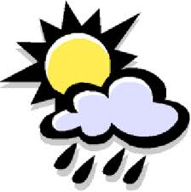
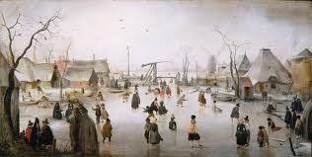
Direct Records of Climate
Recorded temperature, precipitation and
climate data over the past 200 years
Journals, paintings, farming records and oral histories

Slide 3
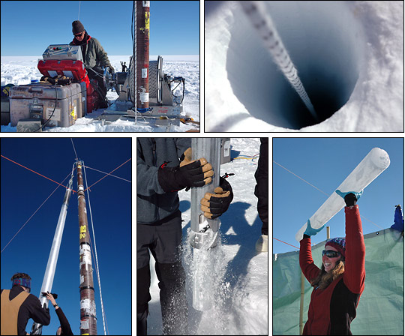
PROXY RECORDS
Indirect records of climate
Ice Core Samples- ice contains air bubbles that have been trapped for thousands of years, the ice at the top of an ice core is very recent and can be 800,000 years old at the bottom!
The air bubbles show the concentration of greenhouse gases and oxygen levels in the past to help determine temperatures

Slide 4
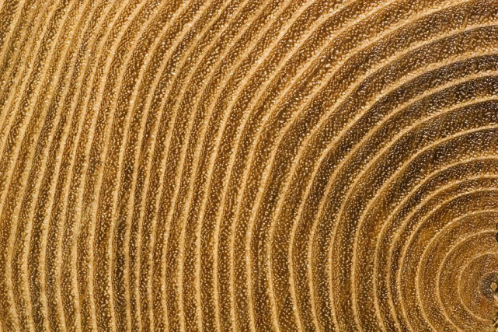
Tree Rings and Coral Reefs- trees create one growth ring per year based on the growing conditions and climate. Coral Reefs also add layers of growth each year and can help determine ocean temperatures.
Rock, ocean sediment and caves- layers of soil and rock build up on the Earth’s surface over time and may contain clues such as plant pollen or fossils.

Slide 5
Read pages 358-360 and answer questions #1-7
on page 361

